Slide 1

Human Powered
AI Solutions
David Hirsch
CM Solutions

Slide 2

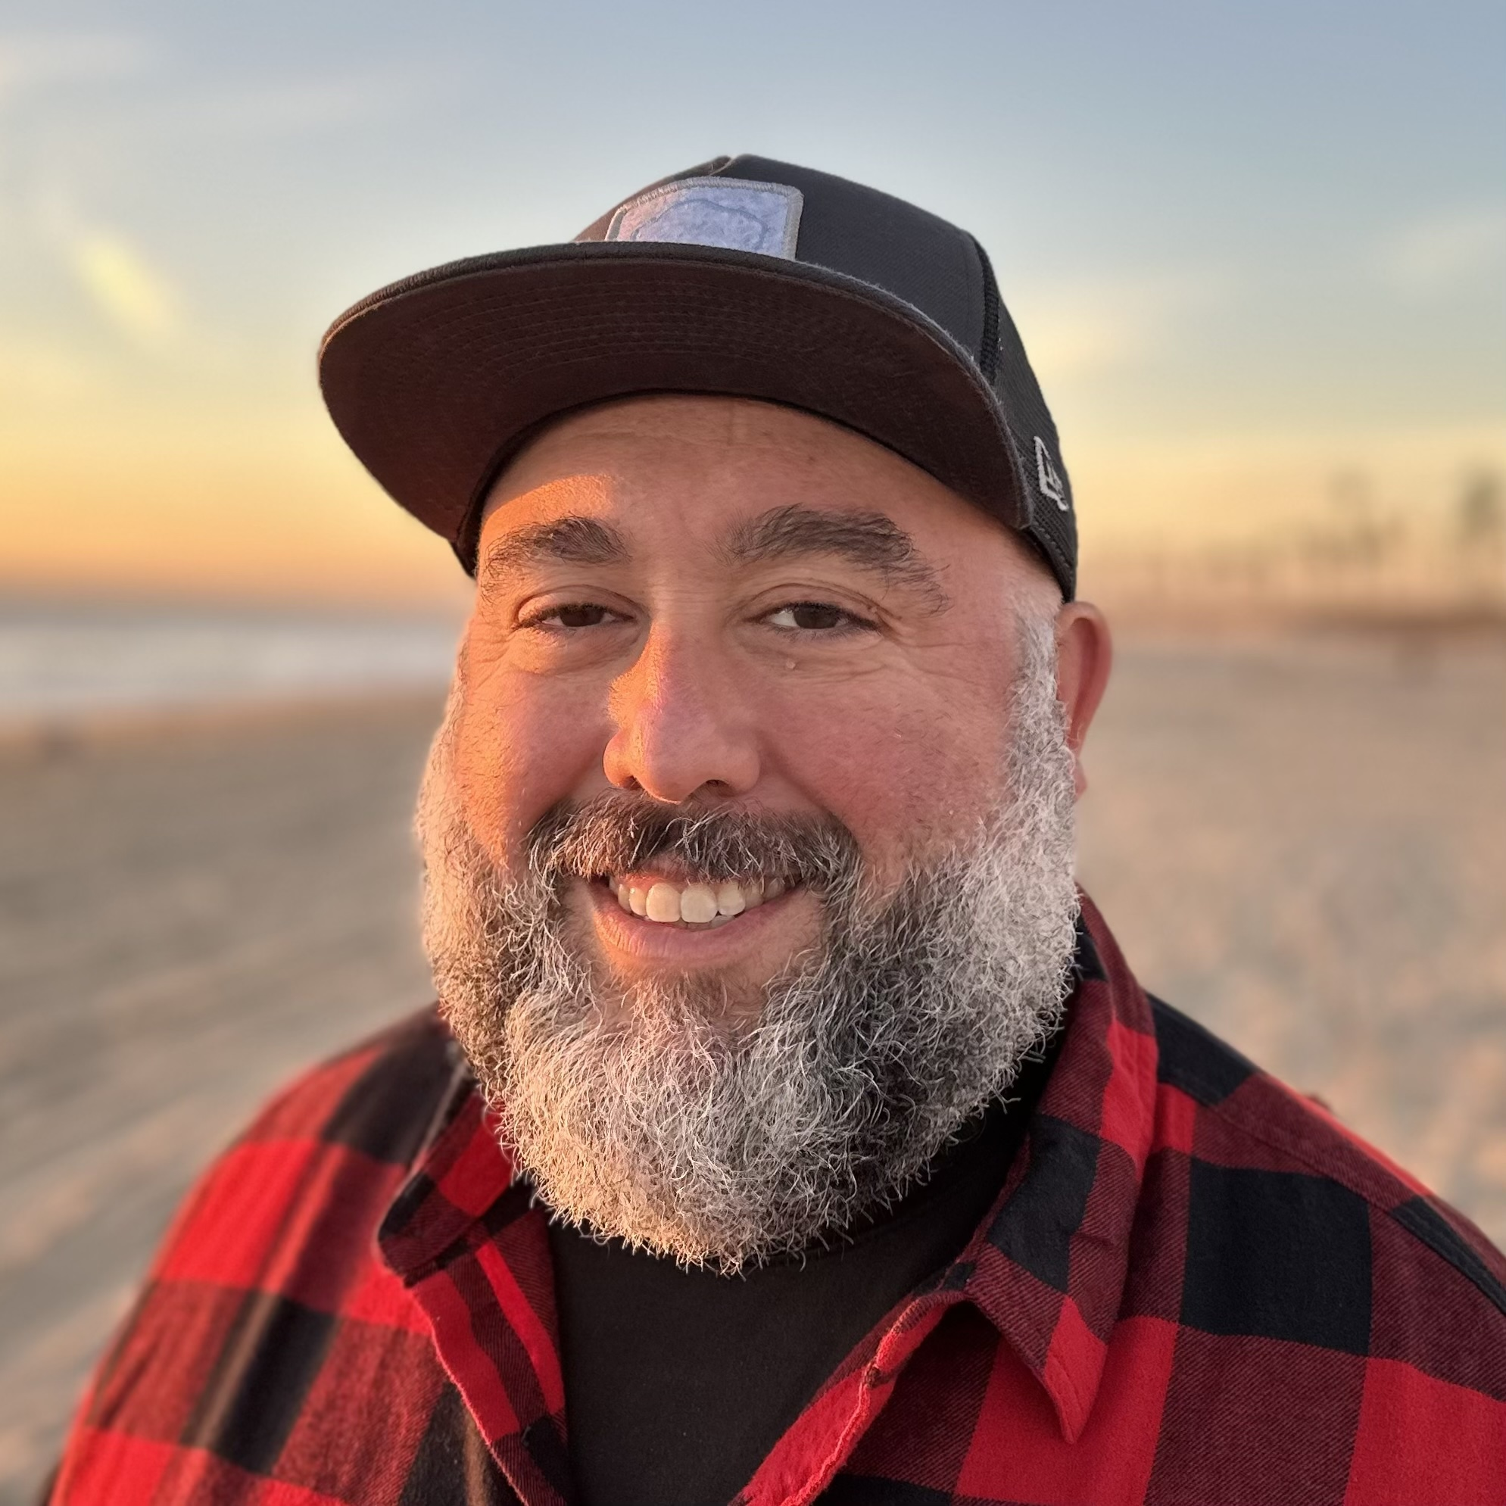
Farid Kheloco
Purely Works

Slide 3
LEAD Consulting and four fires
2025 Goal
2 Clients/MO
Grow to 4/Mo
Expand to new cities

Slide 4
What is the problem
Not enough leads

Slide 5
What is the problem
Not enough qualified leads

Slide 6
What is the problem
Steve & Alan’s time
Not enough qualified leads

Slide 7
What is the solution
Steve & Alan’s time
Closing clients
Coaching clients
delegate & Automate
+ MORE QUALIFIED LEADS

Slide 8
What is the solution
What do you get?

Slide 9
What is the solution
What do you get?
Ai Powered Marketing team
Strategy & implementation Specialist
Administrative assistant
Writing Assistant
Marketing Assistant
AI Developer
AI Powered Alan and Steve

Slide 10
What is the solution
How do we save time?

Slide 11
What is the solution
Scalable efficient Lead vetting
Gather leads (Zoom Info and Apollo)
enrich & SCORE with AI
Lead Vetting – Admin
Send to Steve and Alan (PIPEDRIVE)
How do we Save Time?

Slide 12
What is the solution
How do we Save Time?
Scalable efficient Lead vetting
Ai Content Creation
train agents on style and content
Integrate into Email, CRM, Marketing

Slide 13
What is the solution
How do we Save Time?
Scalable efficient Lead vetting
Ai Content Creation
CRM Development
Single environment for sales
KPI Dashboards
AI enhanced automated lead engagement

Slide 14
What is the solution
How do we Save Time?
Scalable efficient Lead vetting
Ai Content Creation
CRM Development
Integrated Systems
PURELY STAFF

Slide 15
QUESTIONS?

Slide 16
What is the solution
How DO WE INCREASE LEADS?

Slide 17
What is the solution
How do we Increase Leads?
Current Outbound
Zoom Info
Apollo
LinkedIn
Relational

Slide 18
What is the solution
How do we Increase Leads?
Current Outbound
Conferences
Identify conferences
Enriched lead prep
Leverage Relationships

Slide 19
What is the solution
How do we Increase Leads?
Current OUTbound
Conferences
New Marketing
LinkedIn – Webinar
Social Media to Four Fires
Completed OSS – CEOs, FF, Pastors

Slide 20
What is the solution
How do we Increase Leads?
Current Outbound
Conferences
New Marketing
+ Relational Strategic advantage

Slide 21
What is the solution
qualified lead Generation
Current Outbound
Conferences
New Marketing
LinkedIn to Webinar
Social Media to FF
Pastor Emails/Social
}
AI LEAD
VETTING
Sales Calls

Slide 22
QUESTIONS?

Slide 23
What is the process
How will it work?

Slide 24
What is the Process
Simplified Design process
DESIGN
TEST
CUT/ADD
AUTOMATE

Slide 25
What is the Timeline
Marketing Channels
 | Q1 | Q2 | Q3 | Q4
Conference Intel | Build and Optimize
Lead Vetting | Build | Optimize
Current Outbound | Build | Optimize
LinkedIn to Webinar | Build | Optimize | Optimize
Social to Four Fires |  | Build | Optimize
Pastor Email/Social |  |  | Build | Optimize

Slide 26
What is the Timeline
Technology Resources
 | Q1 | Q2 | Q3 | Q4
Writing Agent | Build and Optimize
Conference Agent | Build and Optimize
Lead Enrichment | Build and Optimize
Lead Scoring | Build | Optimize
CRM Development | Build | Build | Optimize
System Integration |  | Build | Build | Optimize
Automation |  |  | Build | Optimize

Slide 27
What is the solution
A Marketing Product?

Slide 28
What is the solution
A Marketing Team
A Partner in ministry
A Partner for Growth

Slide 29
QUESTIONS?

Slide 30
Thank You
David Hirsch
CM Solutions

